Slide 1
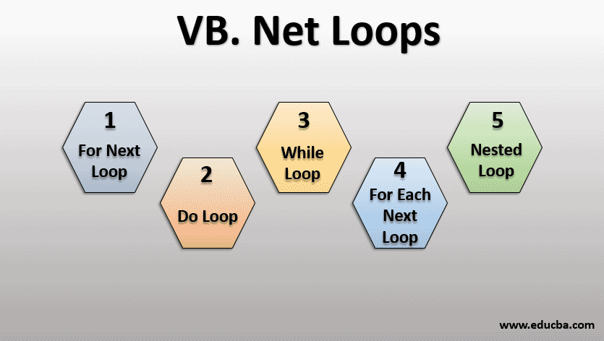
Chapter Seven
Visual Basic Loops, Arrays and More Controls
1008_Introduction to Programming
Compiled by Ms. Dianne Sikinapi & Ms. Odilia Tita

Slide 2
Learning Objectives
By the end of this Unit, students should be able to:
  Know different types of Looping.
  Understand and Work with Arrays
  Know and Create control arrays
  Know List Boxes, Combo Boxes, Drive List Boxes, Directory List Boxes and File List Boxes.
  Know vertical and horizontal scroll bars.
  See Textbook - Introduction to Programming Book 2 Pages 158- 210

Slide 3
7.1 Visual Basic Looping
In programming, there a situations where we need to execute a particular code multiple times until some condition is met. Or we need to do a particular task over and over again until the condition is met. This is repetition. This process of repetition is called Looping.
Whenever there is a situation where we need to repeat some particular block of code, or we need to repeat some tasks, we use Looping.
Generally, the statements are executed one after the other, but while using a loop, it changes the control flow and executes a particular statement for a particular time before the control moves ahead.
A loop allows us to execute a statement or group of statements multiple times.
Looping is prevalent in almost every program written. Rarely do you write a program that is a straight sequence of instructions.

Slide 4
In Visual Basic, there are three types of Loops that can be used in program instructions to repeat tasks.
  Do…Loop – repeats a block of code until a condition is True or False.
  For…Next Loop– repeats a block of code a specified number of times.
  While…Loop – repeats a block of code as long as a condition is True.
  For Each…Next Loop – repeats a block of code once for each element in a collection.
  Nested Loop – a loop inside another loop.
A loop statement allows us to execute a statement or group of statements multiple times.

Slide 5
7.2 Arrays
An Array is a collection of elements of the same data type.
Arrays store a collection of data, and each element can be accessed by an index number.
Arrays are of fixed size. We declare the size of the array when initializing it.
We can initialize arrays as follows:
Dim vowels ( ) As Char = {“a”, “e”, “i”, “o”, “u”}
The type of elements in the array should match with the data type of the array itself.
The size of the array, also called the length of the array, must be specified in the declaration itself. Once declared, the size of an array cannot be changed. Because when an array is declared, the compiler allocates a continuous block of memory required to store the declared number of elements.

Slide 6
How to use an array in Visual Basic program:
  Declare an array by specifying its size when it is declared.
  Access each location in the array using an index of type Integer.
  Populate an array with array literals.
  Iterate through an array.
  You can also change the lower bound, store Variant values in arrays, and use multidimensional arrays.
Array elements are stored in contiguous memory locations. Each element is identified by an index starting with "0". The lowest address corresponds to the first element and the highest address to the last element.

Slide 7
Control Arrays
It is very useful to define control arrays, depending on the application
It is a convenient way to handle groups of controls that perform a similar function. All events available to a single control are still available to the array of controls, the only difference being an argument indicating the index of the selected array element is passes to the event.
Hence, instead of writing individual procedures for each control, only one written procedure for each array.
You can add or delete array elements at run time which you cannot do that with the controls (objects).

Slide 8
Ways to control Arrays
Create an individual control and set desired properties. Copy the control using the editor, then paste it on the form. Visual Basic will pop-up a dialog box that will ask you if you wish to create a control array. Respond yes and the array is created.
Create all controls you wish to have in your array. Assign the desired control arrays name to the first control. Then try to name the second control with the same name. Visual Basic will prompt you, asking you want to create control arrays. Answer yes. Once the array is created, rename all remaining controls with that name.

Slide 9
Properties of an array in Visual Basic programming includes:
  Creating an array: You can define the size of an array when it is declared.
  Storing values in an array: Access each location in an array using an index.
  Populating an array with array literals.
  Iterating through an array.
  Key properties for manipulating arrays:
    Length property: Returns the number of elements in an array.
    Rank property: Returns the number of dimensions in a multi-dimensional array.
    Is Fixed Size property: Indicates whether an array has a fixed size.

Slide 10
Summary
Read Chapter Summary Notes on Page 207 of Introduction to Programming Book 2.
Review Exercises
Complete all 9 review questions on Page 208 of Introduction to Programming Book 2.
Try to at least do Hands-On Programming Examples and Exercises

